Slide 1

KL(Klemme) Information

Slide 2
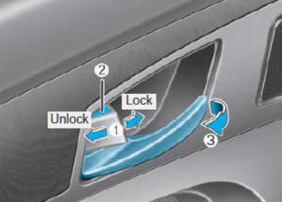

KL30 is the constant power line from the vehicle battery to the ECU. It supplies voltage at all times—whether the car is on or off—so some ECUs send constant power line like central locking, and alarm can keep running even when the car is off.
KL15 is the ignition signal(ON) from the car key (equivalent to the IGN position). It activates when the key is turned to start the engine and powers critical ECUs like ABS, ESP, and chassis systems.
KL31 is the ECU ground connector, which connects to the vehicle's negative battery terminal. It is generally connected to shared ground points throughout the vehicle, such as the engine, body, chassis, and other locations, to provide a single ground for several ECUs.
Example:

Slide 3

KL15R (R = Radio) refers to the ACC position—when the key is turned to power accessories like the radio, dashboard, doors, or windows, but the engine is still off.
KL50 represents the car’s crank mode(Start), Engine Running.
.

Slide 4

KL-30 Representation
ECU-1
ECU-2
ECU..n
Battery
ECU-3
ECU-4
ECU..n
Ground
equivalent to the IGN position KL-15

Slide 5
KL40 represents the positive terminal of a 48V battery.
KL41 represents the negative pole of a 48V battery
Many modern vehicles, especially mild hybrids, are adopting 48-volt electrical systems, including models from manufacturers like Audi, Mercedes-Benz, and Tesla.

